Slide 1
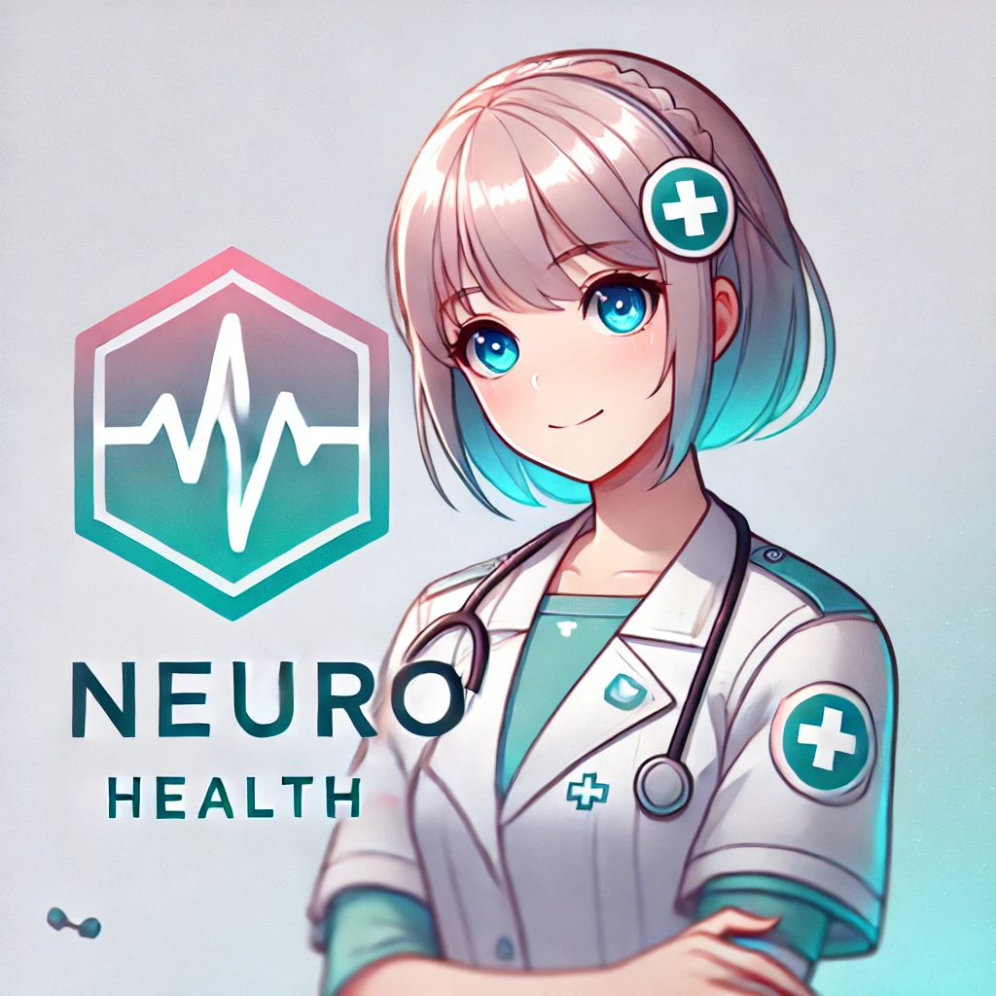

Neuro owo
AI-Powered Personalized Health Agent
This presentation explores Neuro Health, an AI-based application designed for personalized health management. We'll delve into its core features, technical realization, and potential applications.
Li Zongze, Cheng Jingxuan, Zhang Zhaoxiang
Nanyang Technological University, Singapore

Slide 2
Neuro owo
A Comprehensive Solution
Multimodal Sensing
Dynamic Personalization
Neuro Health integrates data from various sources, including wearables and user input.
Dynamic reinforcement learning adapts health plans based on user feedback and progress.
Privacy-Preserving Framework
Secure computing frameworks protect user data while enabling data analysis.

Slide 3



Core Features
Beyond Basic Pedometer Functions
Personalized Plans
Smart Reminders
Data Storage
Stores comprehensive health profiles, including medical history and lifestyle data.
Generates customized health plans tailored to individual needs and goals.
Provides timely reminders for exercise, medication, and other health-related tasks.

Slide 4

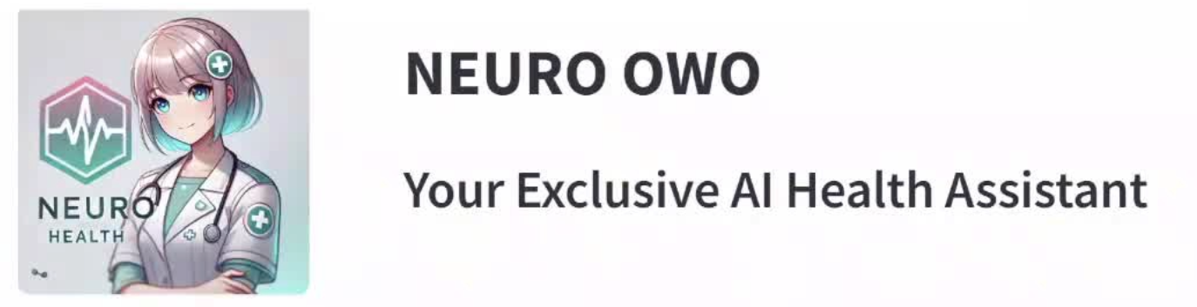
Technical Realization Overview: Intelligent Interaction Agent
YOLOv11m-Pose-finetune
Recommendation Engine
Use the finetune yolo-based-model to detect users’ sports movement and make classification
Deepseek-based AI agent to make suggestions about daily workout
1
2
3
Visualized Workout Management App
Based on the stremlit technology, the app is built to fit public’s favor

Slide 5
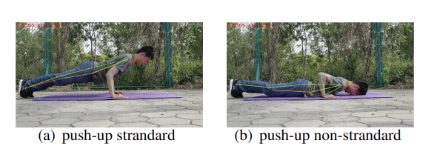

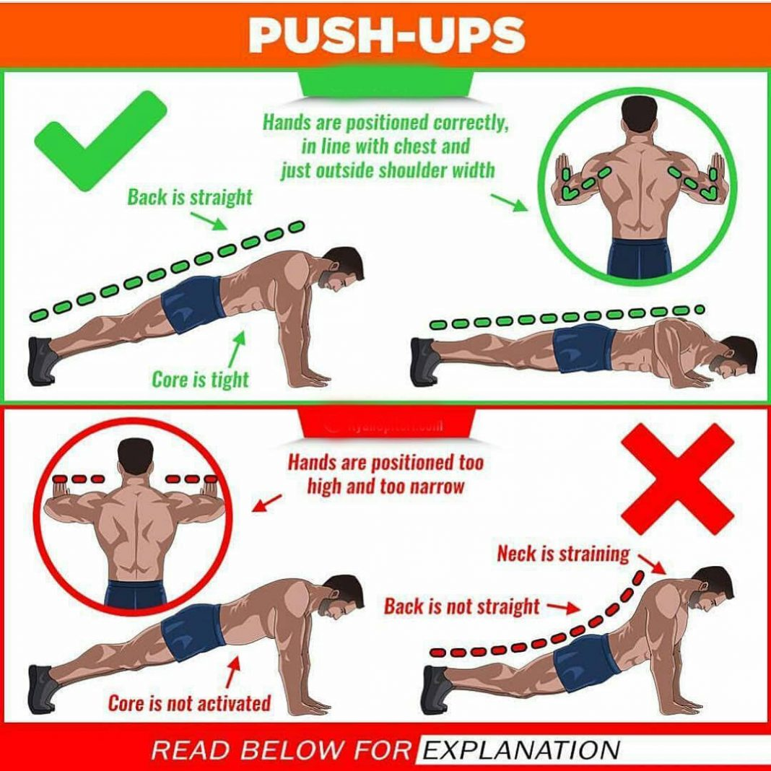


Body-Pose Estimation
Repetitions Counting, and Posture correctness evaluating
Datasets
HSiPu2 is a dataset that includes key points of motion postures and whether the actions meet the standards. It contains 5,030 images along with labels.
labels like <class-index>... <px1> <py1> <p1-visibility>...
Technical Approach
Finetuning based on the yolo11m-pose and use a simple classifier to make classification
Real-Time Feedback
use tensorRT to accelerate the inferrence so the inferrence delay can be reduced to 5ms nearly real time

Slide 6
- NEURO OWO -
Your Exclusive
AI Health Assistant
Personal Healthcare
Record your health & sports data
Provide personalized assistance
Exercise Analytics
Automatically get data from smart devices
Capture your training with the camera
Visualizations for your sports training data
AI Health Suggestions
Comprehensive health analysis
Exclusive suggestions for exercise, diet plan, healthcare, water intake …

Slide 7
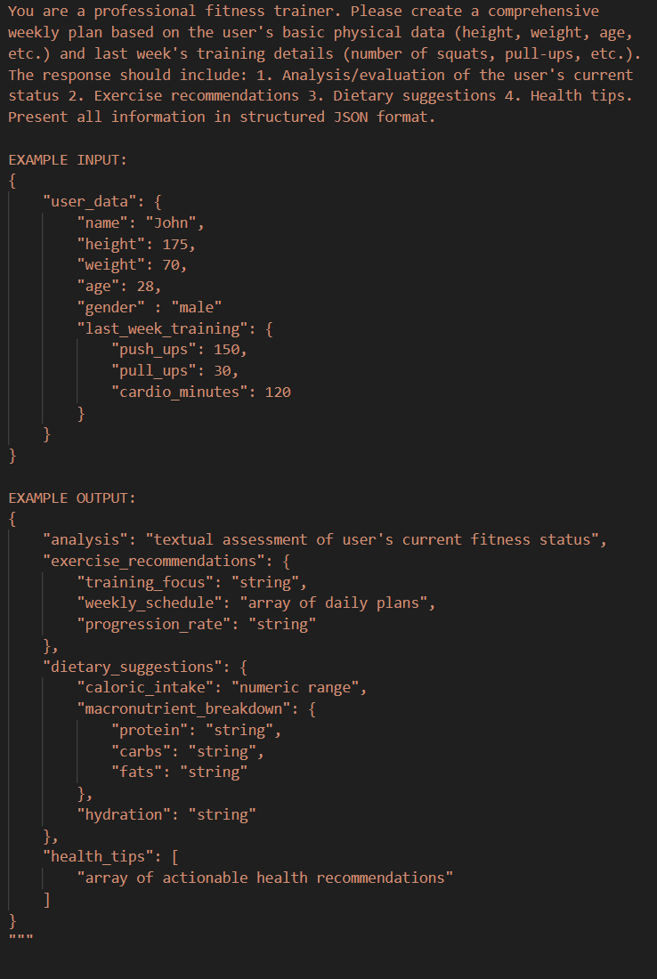

Prompt-engineering
Use previous week workout data to make suggestion
DeepSeek-based workout-trainer
Using API to get response from deepseek and provide personalized recommendations.
Formatted Input
Using formatted input to make deepseek can get the information more clearly
Formatted Output
Formatted output can make the APP we made easily build suggestion and visualized it to fit humans’ favor

Slide 8
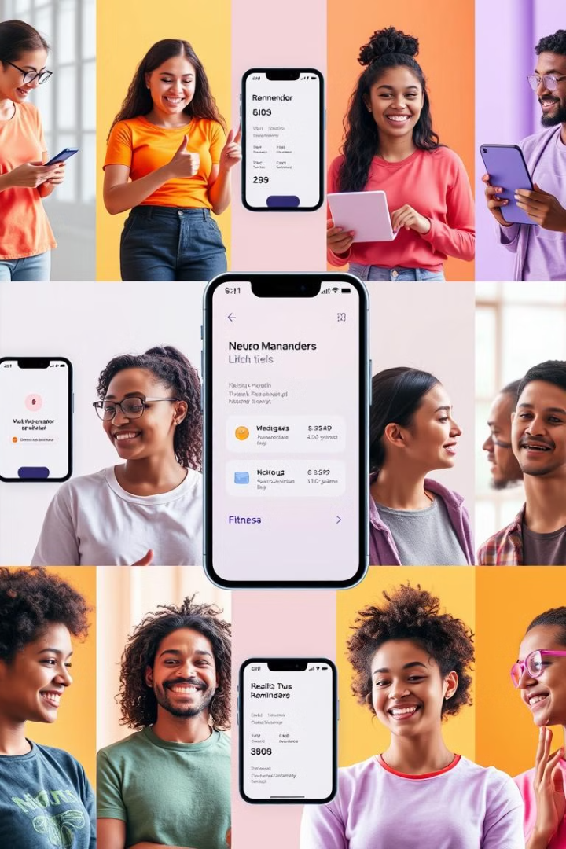
Application Scenarios
Empowering Users to Take Control of Their Health
1
2
Fitness Enthusiasts
Chronic Disease Management
Personalized workouts, real-time monitoring, injury prevention.
Reminders, alerts, and communication with healthcare professionals.
3
Busy Professionals
Sedentary reminders, quick nutritional tips, sleep scheduling.

